Slide 1
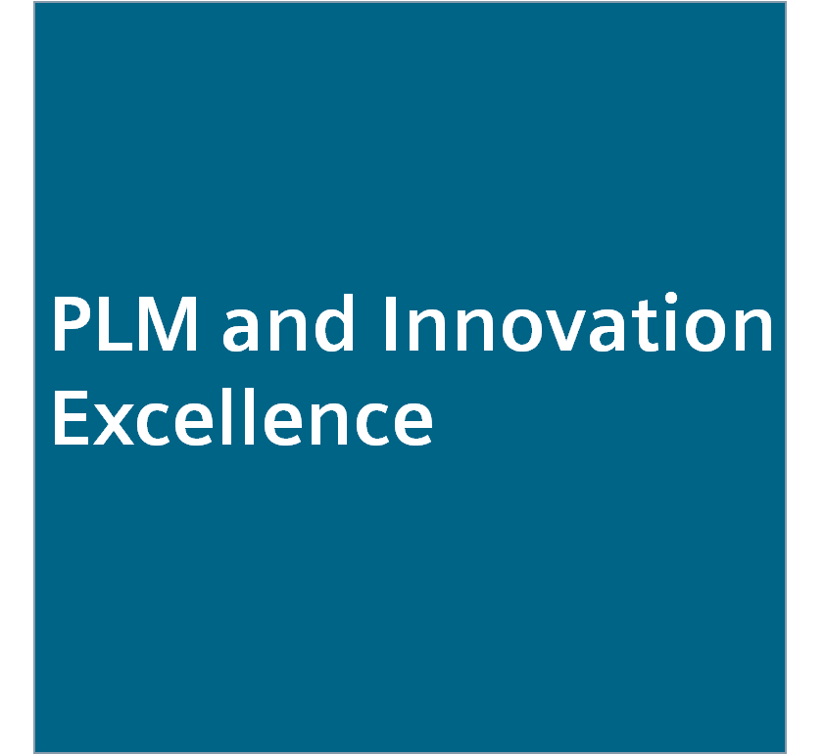
The Siemens Development System Introduction January 2018
PLM and Innovation Excellence - Siemens Operating Model
CT RDA DS EU CZ

Slide 2
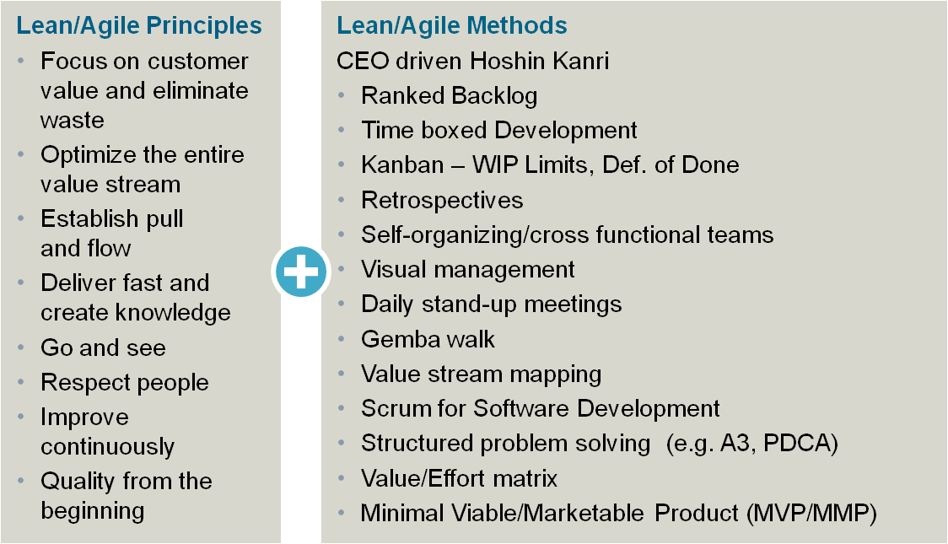
Siemens establishes a Siemens Development System in PLM to become much faster and flexible
Executive Summary – Siemens Development System
8 + 14
~ 40 till FY17
~ 300 till FY19
~ 1000 till FY21
Set of common, business-proven principles and methodologies
One SDS manager per BU
Clear mandate based on full management commitment
Dedicated time and budget for continuous improvement activities and knowledge exchange
Act on behalf of BU in lean communities and networks
Lean leadership
PLM heads: CTOs, R&D, ENG and PPM
PLM and Innovation Excellence Board as role model
Culture Lab - 1 day
Go and see with 1-2 visits p.a. to best-in class BUs
Lean for Leaders: 2+2 day coaching & training
Functional experts
Strengthen expert programs based on BU needs
Continue with lean experts
Adapt R&D project manager development to SDS
Integrate SDS in system / SW architects programs
1
2
3
4
The PLM and Innovation Board, representing all Divisions of Siemens decided on September 9, 2016 to implement the Siemens Development System (SDS)
SDS = Siemens Development System, p.a. = per annum, SPS = Siemens Production System
Source: Decision of PLM and Innovation Baord on Sep. 9, 2016

Slide 3
Having the right mindset in place, the SDS method framework is the “operating toolkit” to become much faster and more flexible across PLM
1
Value
stream mapping
Structured problem solving
(e.g. A3)
CEO driven Hoshin Kanri
Retro- spectives
Time Boxed Development
Visual Management
Scrum
Self-organizing / cross functional teams
Ranked Backlog
Gemba walk
Value effort matrix
Minimal viable / marketable product
MVP/ MMP
Kanban – WIP limits, definition of done
Daily stand-up meetings
The SDS methods are tools to implement modern development approaches

Slide 4
Eight principles of the Siemens Development System
Focus on customer value and eliminate waste | We know our customers and strongly focus on their benefit. We eliminate all types of non-value adding activities.
Establish pull and flow | We organize work and empower people to create fast, flexible and continuous flow – we limit work demand to capacity and maximize throughput.
Go and see | We go to the place of action and see what really happens in order to accelerate communication and decision making. We ask for impediments and offer support.
Improve continuously | We keep on improving. Lean is a journey, not a final state.
Optimize the entire value stream | We foster effective, trustful and networked collaboration between all involved global and local functions along the entire value stream.
Deliver fast and create knowledge | We actively request customer feedback in fast iterations. We encourage systematic learning and continuous knowledge exchange.
Respect people | Our teams thrive on pride, commitment, trust and applause. We value colleagues from other functions and their competence and contributions. Our managers respect their employees and provide support.
Build quality in from the beginning | We build in quality from the start. We regard problems as treasures. We detect them immediately at the point of origin and sustainably solve the root cause.
Done
Done
In Progress
Done

Slide 5
Methods of the Siemens Development System (1/2)
CEO-driven Hoshin Kanri | A strategic planning methodology, applied on BU / Segment level and used to align goals between all functions.
Time-boxed development | Strive for iterative, incremental interdisciplinary development or commissioning to gain early feedback, ideally in fixed time frames.
Retrospectives | Systematic approach to regularly reflect collaboration and team work in short cycles by identifying good practices and possible improvements.
Visual management | Key information for daily work is visualized to get transparency as basis for open and trustful communication across all hierarchical levels in order to improve efficiency and overall performance.
Ranked backlog | Ordering the work packages as guidance for daily work – what needs to be done before the next step – as early alignment and commitment of all functions involved.
Kanban – WIP limits, definition of done | Balancing of work in progress (WIP) with the available capacity, transparent communication of status and clear definition of completion criteria to improve lead time and efficiency.
Self-organizing / cross-functional teams | The team includes all functions necessary to get the work done and decides HOW it’s going to do its work within the given business constraints and without departmental thinking (silos), but rather focused on product, solution, etc.
In Progress
Done
Done

Slide 6
Methods of the Siemens Development System (2/2)
Daily stand-up meetings | Daily / regular meetings on all hierarchical levels to communicate: • What did I accomplish? • What do I plan to achieve until the next stand-up? • What obstacles are impeding my progress?
Gemba walk | Go and See by management replacing reports and indirect information capturing.
Scrum for software development | A time-boxed iterative and incremental approach using ranked backlogs and visual management.
Value / Effort matrix | Evaluation and prioritization of work packages based on their value and implementation effort, e.g. to create a ranked backlog.
Value stream mapping | Method to analyze and optimize the process based on the value stream.
Structured problem solving (e.g. PDCA) | Structured approaches to guide collaborative in-depth problem solving by identifying root causes, and to continuously improve on all levels.
Minimal viable / marketable product (MVP / MMP) | Develop a system in smallest usable chunks to gain fast (customer) feedback.
Done
Done
In Progress

Slide 7
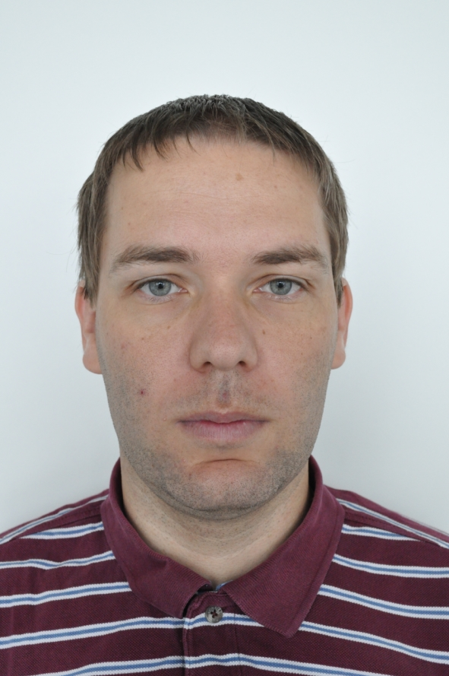
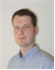
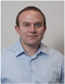

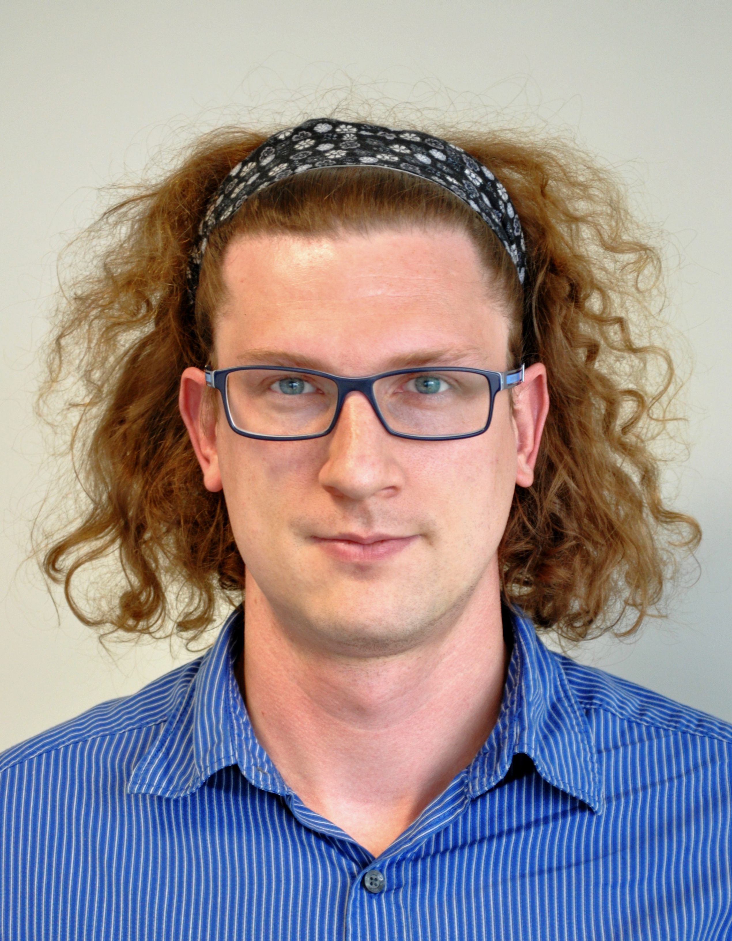
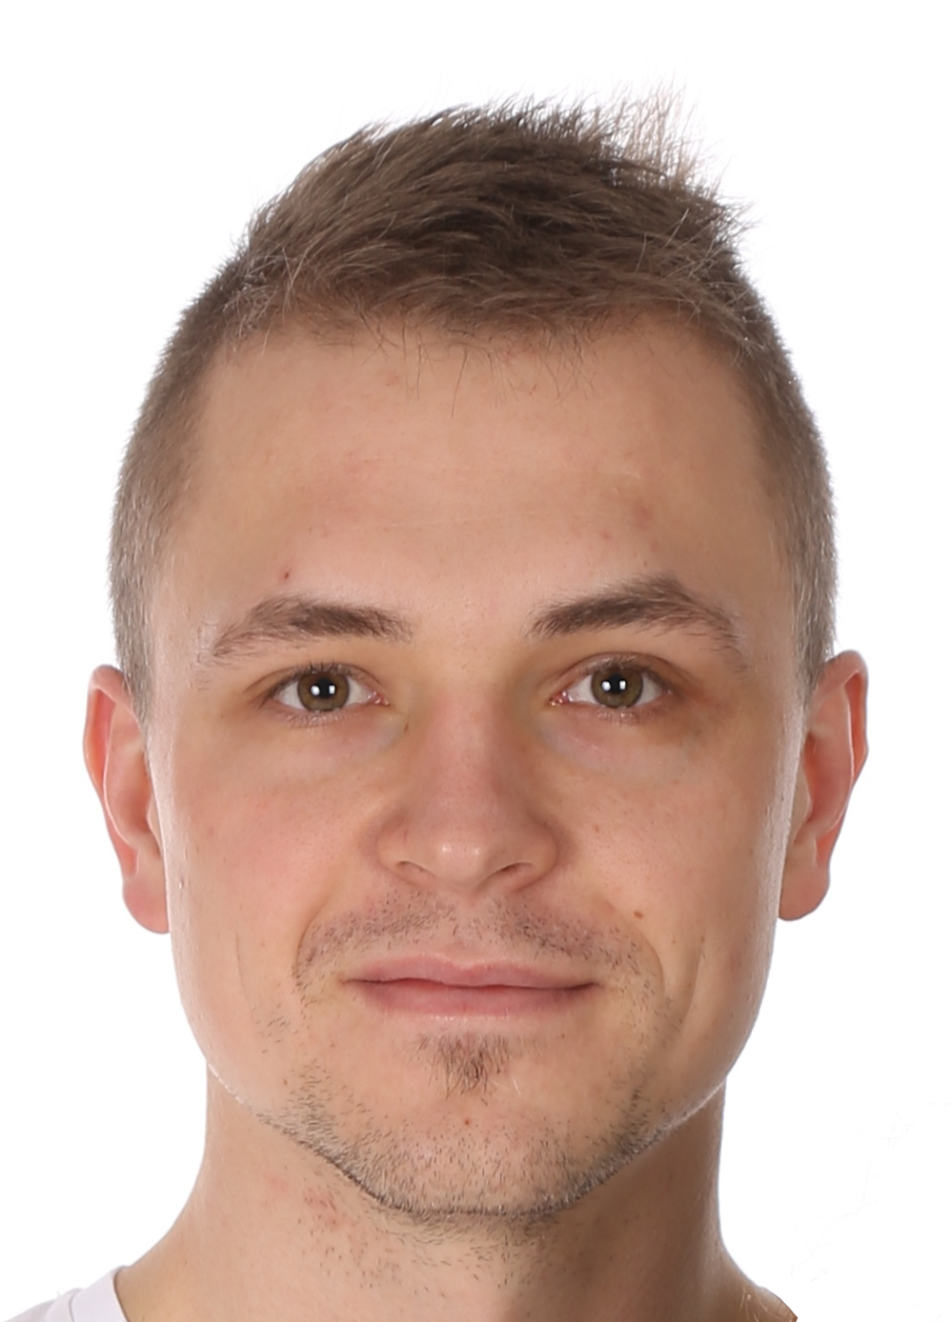
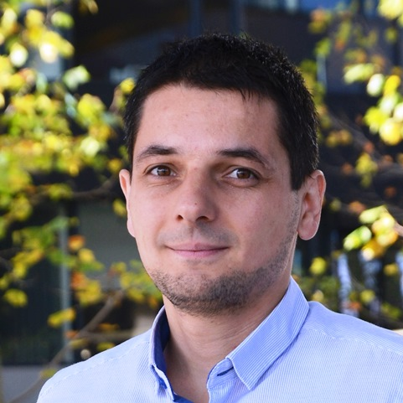
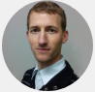
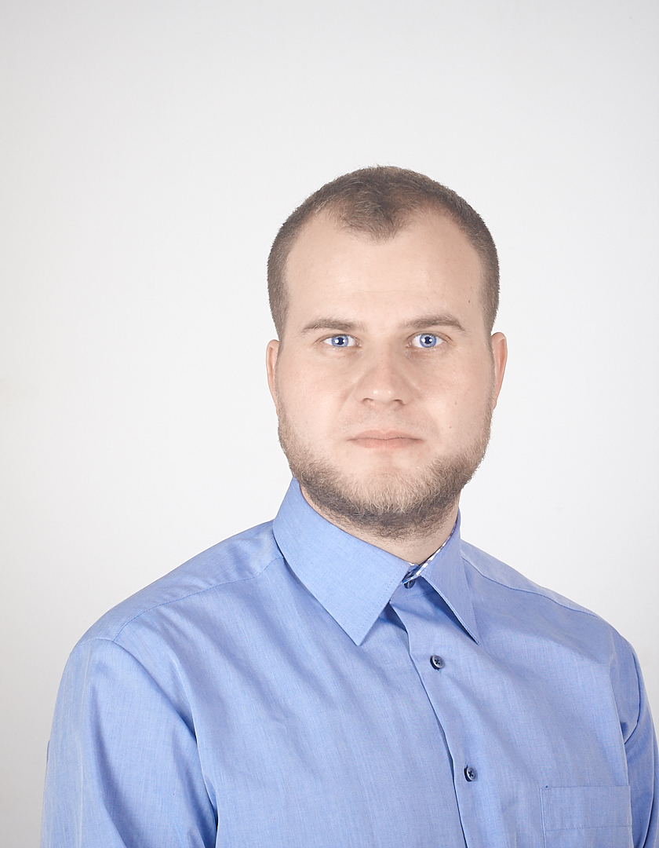
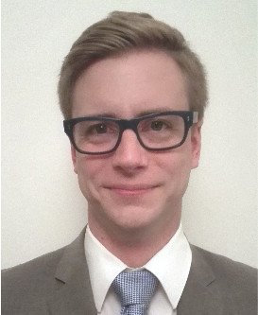
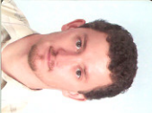
SDS Team in CT RDA DS EU CZ
Jiri Cihak
CT RDA DS EU CZ RA SW
Established 11/2017
Meetings every 2 weeks
10 team members
self nominated
beyond daily work
different working positions (Segment and Sub-segment head, Team leaders, developers, ...)
different roles (SW AR, SAM, HW DEV, QM, QMiP, ...)
different departments (ITS, RA, DF, PD, QM, ...)
different experience and knowledge regarding SDS / agile / lean
fully supported by top management as well as customer
common goal
DOING ALWAYS THE RIGHT THINGS CORRECTLY AND AT THE FIRST TIME
Hynek Urbis
CT RDA DS EU CZ DF
Lukas Hamacek
CT RDA DS EU CZ RA
Siemens acts and is perceived as an
Entrepreneurial
Innovation leader and
Digital champion
Olga Sebestova
CT RDA DS EU CZ RA QM
Martin Laza
CT RDA DS EU CZ PD AP
Michal Aftanas
CT RDA DS EU CZ RA HW
Radomir Martinek
CT RDA DS EU CZ DF SE 1
Jakub Makarovsky
CT RDA DS EU CZ DF MP 6
Martin Staron
CT RDA DS EU CZ DF CP 1
Vojtech Sladky
CT RDA DS EU CZ QM
Pascal Cassinelli
CT RDA DS EU CZ ITS SW 2

